Slide 1
Spider web simulation
Changrui Cai & Jiahua He

Slide 2

Introduction
When an insect flies into a spider's silk, what kind of deformation does the spider silk undergo?

Slide 3

Simplify
Spider Web Structure: The spider web is simplified into a regular octagonal structure, where each points are connected to the central point by a single rod.
Fixed Points: The eight points of the octagon are fixed in space and do not move.
Simplified Impact Force: The insect's impact is simplified as a continuously decreasing force applied to the central point of the web.

Slide 4
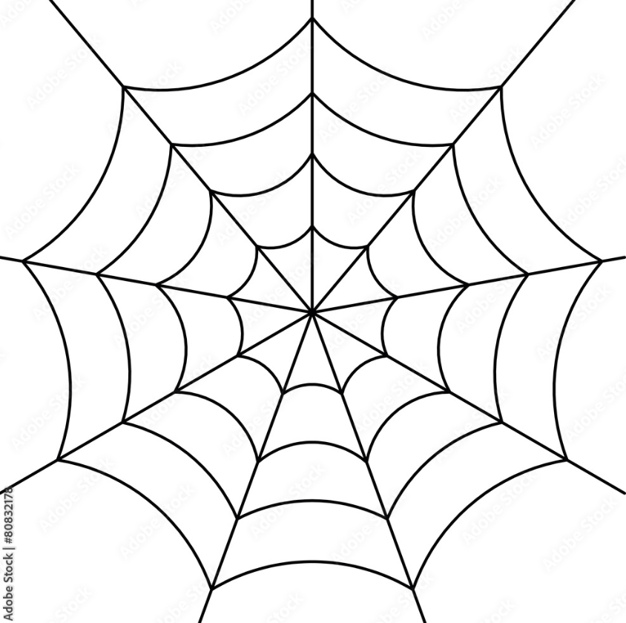
Assumption
Young's modulus of spider silk ranges from 1.5 to 12 gigapascals. Our team choose 5 gigapascals in general.
The diameter ranges from 0.2mm to 1mm. Our team choose 0.5mm.
From the reference the damping coefficient of the spider silk is 0.3.

Slide 5
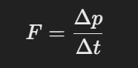
To get the force of the fly
1. Approximate Values of Known Parameters
Spider Mass (m): The average mass is approximately 10–15 milligrams (0.01–0.015 grams). Let m=0.012 kg.
Spider Flying Speed (v): Typically 1–2 meters per second (7km/hr) , take v=1.5 m/s.
Collision Time (t): Spider silk generally has elasticity, collision time may range from 0.01–0.1 seconds. Let t=0.05 s.
2. Calculating Impulse and Force
According to Newton's Second Law and the formula for impulse:
Where:
F is the force,
Δp=m⋅v is the change in momentum,
Δti s the duration of the collision.
So we can have F = 0.36N.

Slide 6
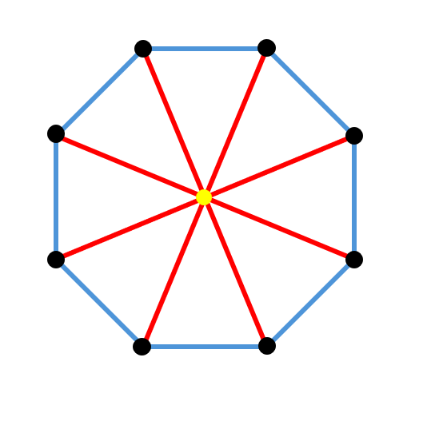
Boundary Condition
Blue Line: Fixed Octagon edges (L=1cm)
Red Line: Rod to center (L=1.7cm)
Black Point: Fixed point
Yellow Point: Center point
Young's modulus | Diameter of Spider web | Maximum impact force | Damping coefficient
5GPa | 0.5mm | 0.36N | 0.3

Slide 7
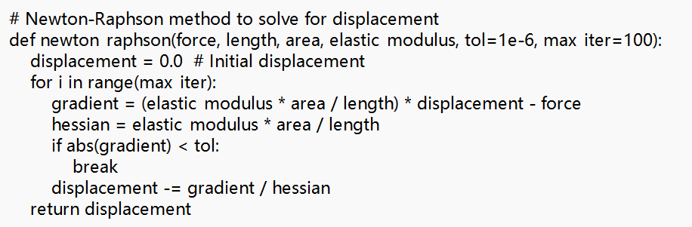
Method
Newton-Raphson method
tolerance = 1e-6
total time = 0.05s
dt = 0.0001s
gradient = (elastic_modulus*area/length)*displacement – force
Hessian = (elastic_modulus*area/length)

Slide 8
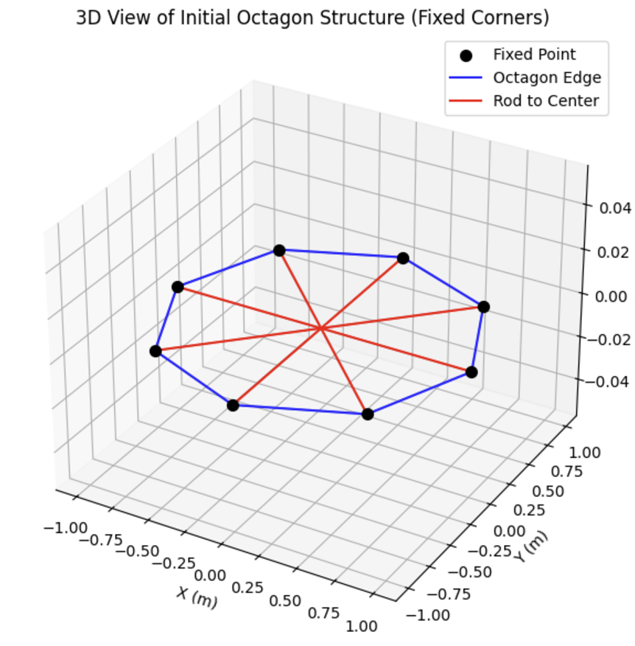
Initial state
Create an octagonal mesh, with each line pointing toward the center as an independent rod. Due to symmetry, assume that all edges of the octagon are fixed.
Apply a decreasing force at the center of the octagon. Use the Newton-Raphson scheme method to solve for the displacement.
F

Slide 9
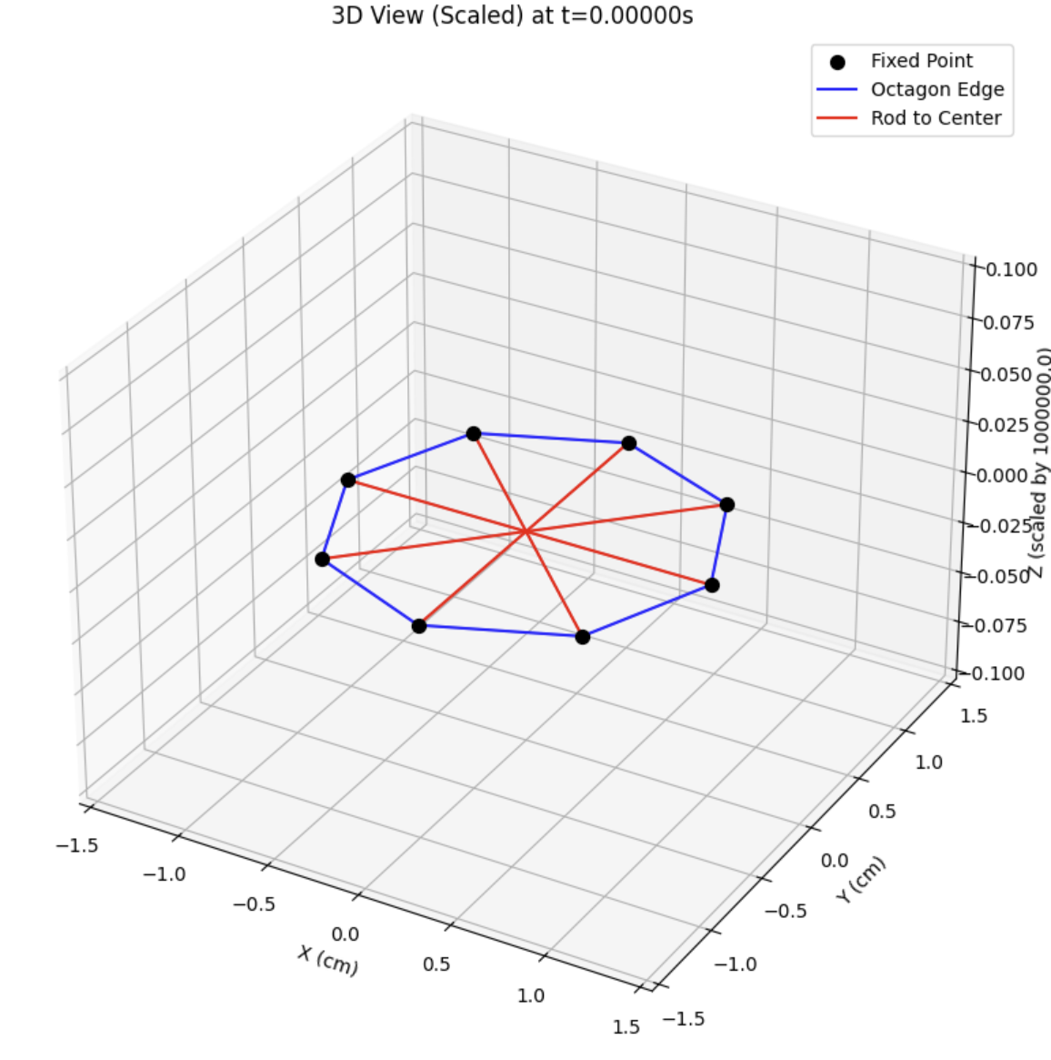
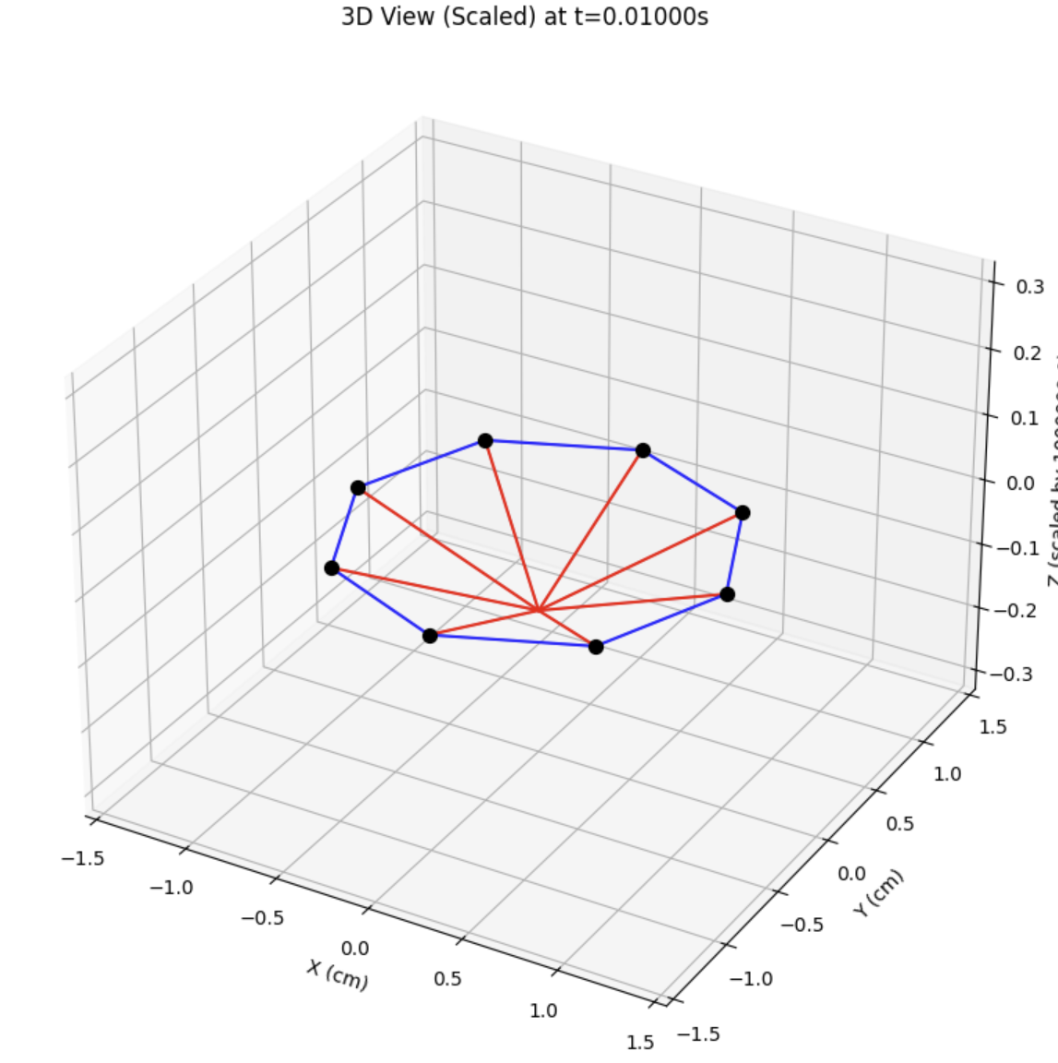
t = 0.0s
t = 0.01s

Slide 10
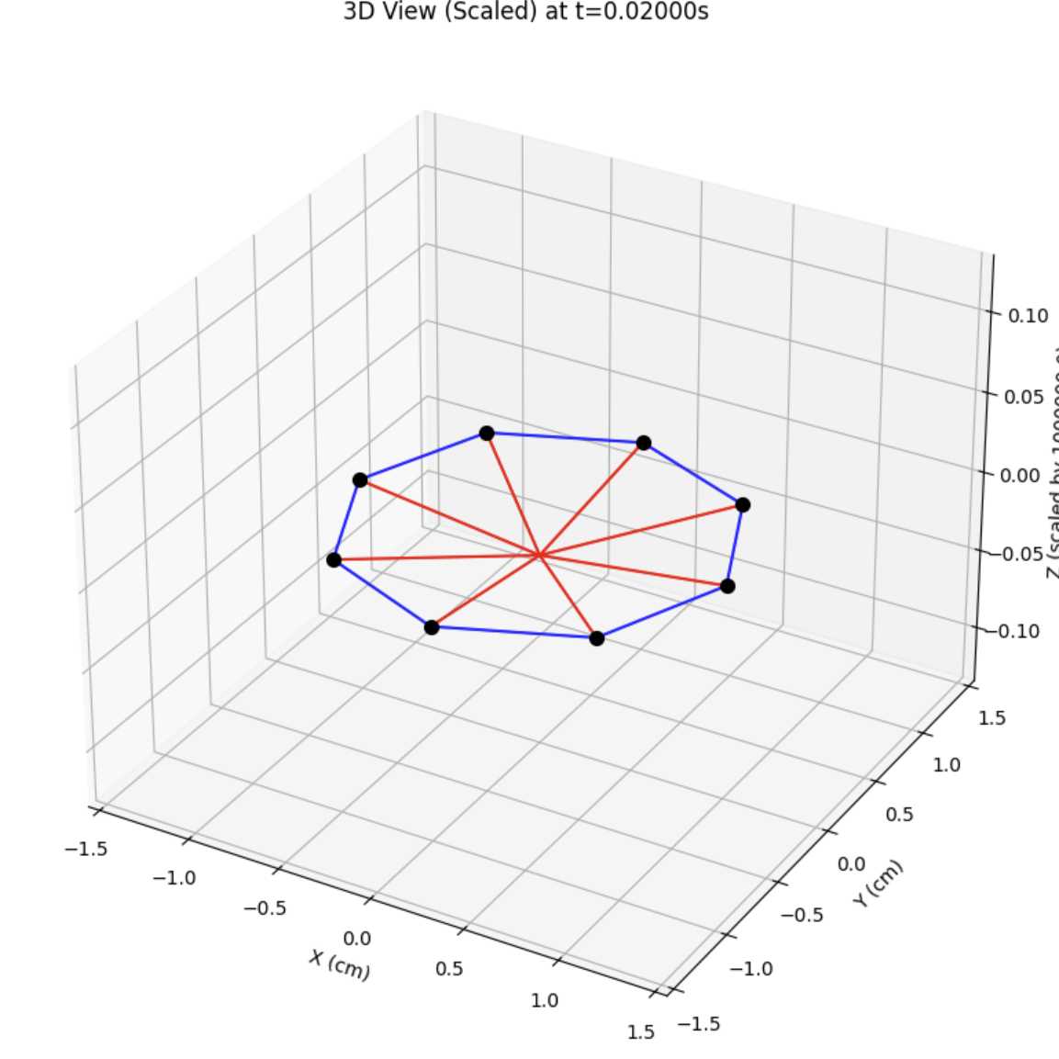
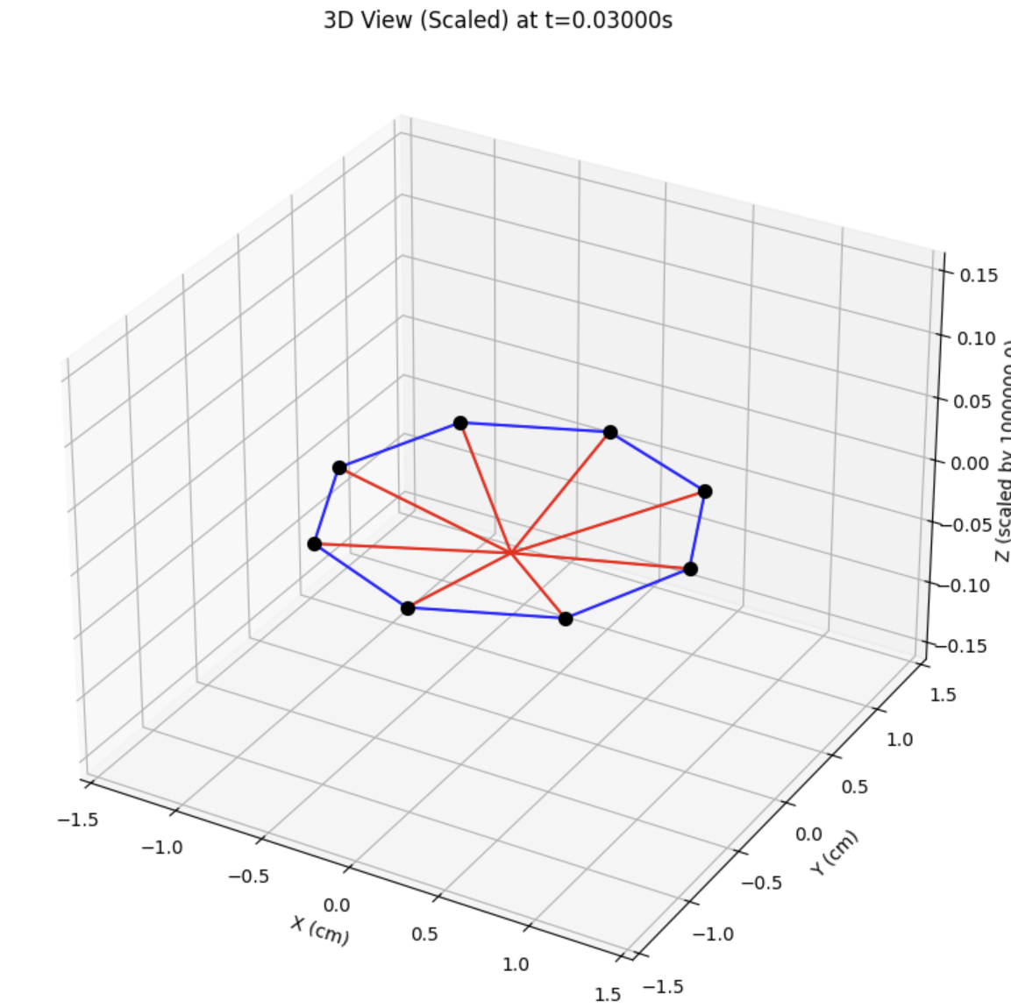
t = 0.02s
t = 0.03s

Slide 11
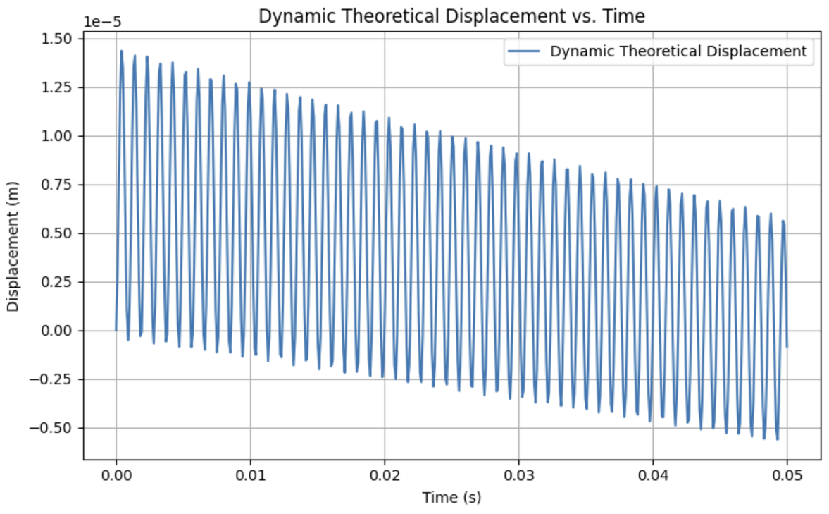

Slide 12
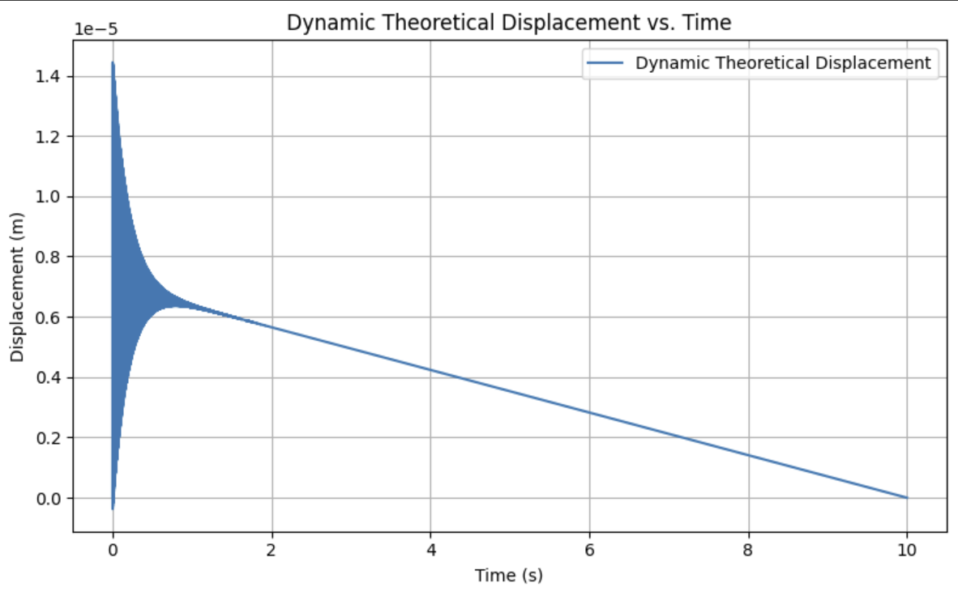

Slide 13
Constrain
The adhesive force is not considered
The mass of the web is not considered
The spider web structure is a standard geometric shape, but in reality, the structure will becomes more complex

Slide 14
Reference
[1] M. Chen, Z. Wang, K. Li, X. Wang, and L. Wei, “Elastic and Stretchable Functional Fibers: A Review of Materials, Fabrication Methods, and Applications,” Advanced Fiber Materials, vol. 3, no. 1, pp. 1–13, Jan. 2021, doi: https://doi.org/10.1007/s42765-020-00057-5.
[2] Maria Gessica Ciulla, Alessio Massironi, Michela Sugni, M. A. Ensign, S. Marzorati, and Mahdi Forouharshad, “Recent Advances in the Development of Biomimetic Materials,” Gels, vol. 9, no. 10, pp. 833–833, Oct. 2023, doi: https://doi.org/10.3390/gels9100833.
[3] A. Powers, “Spider Silk: Sronger than Steel? Nature’s Supermaterial,” Berkeley Scientific Journal, vol. 18, no. 1, 2013, doi: https://doi.org/10.5070/bs3181020651.
[4] K. M. Babu, “Spider silks and their applications,” Silk, pp. 235–253, 2019, doi: https://doi.org/10.1016/b978-0-08-102540-6.00010-3.
[5] M. K. Jawed and S. Lim, Discrete Simulation of Slender Structures. 2022.
[6] O. M. O’Reilly, “Kirchhoff’s Rod Theory,” Interaction of mechanics and mathematics, pp. 187–268, Jan. 2017, doi: https://doi.org/10.1007/978-3-319-50598-5_5.

Slide 15
Thank you

